Slide 2

Hwhy?
Do you find yourself troubleshooting bad-performing queries?
But don’t want to autowire EntityManager or write full JDBC queries?
And want to stay with JQPL and JPARepository?
Have you ever had ORM Headaches?
N+1 problem (parent query, then one query for each child)
lazy/eager fetching gotchas
Do you just want a fast DB read without needing to update the data for that request?

Slide 3
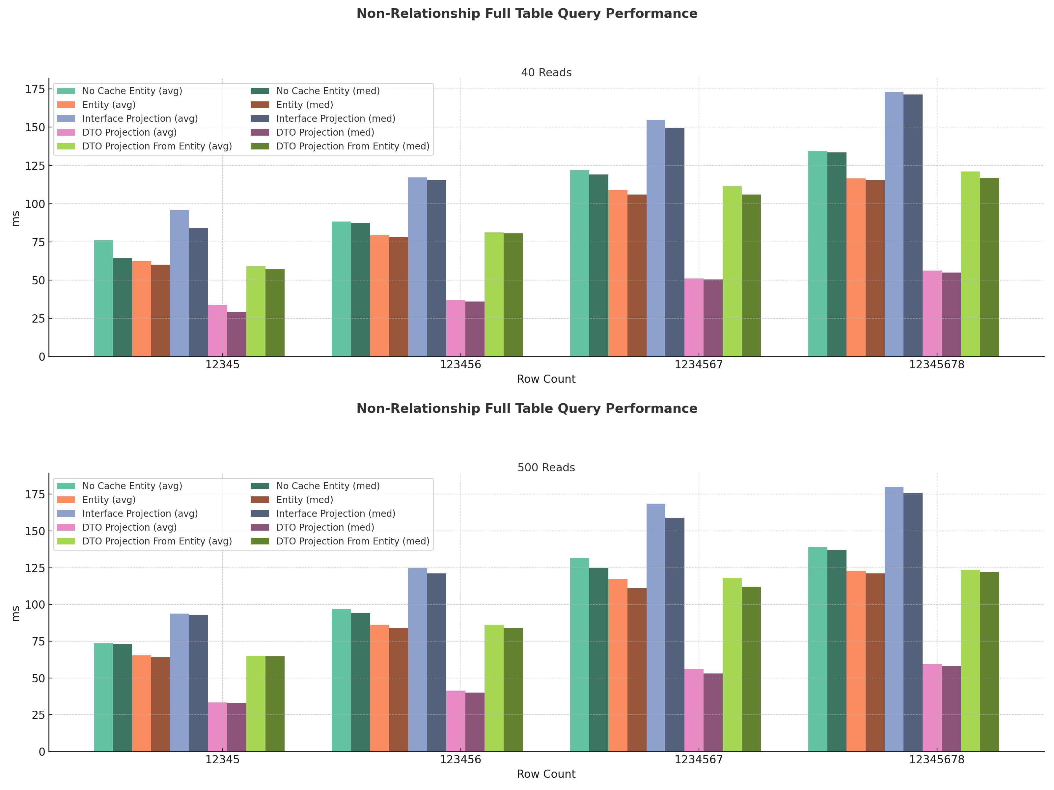


Slide 4
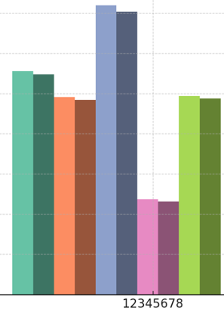
Results
Average across the cases:
53% speed improvement
AKA 2.12 times as fast
Worst data point of pink (58) better than the best datapoint for orange (60)
This is comparing the average of 500 reads of 1,234,567,800 rows against the average of 40 reads of 1,234,500 rows. That is more than 1000x the row count.
I had read to expect them to take about 63% as long on average
AKA 1.6x faster
Did mine do better because it removes the offset of network latency?

Slide 5

What is this sorcery?

Slide 6
What is a Projection?
a Projection is a way to select and return a subset of the fields from an entity instead of the whole entity
A Projection query is a JPA query which returns a read-only, unmanaged view of the data
Projection types are types residing outside the entity’s type hierarchy (it's not the entity, it's not a subclass of the entity)

Slide 7
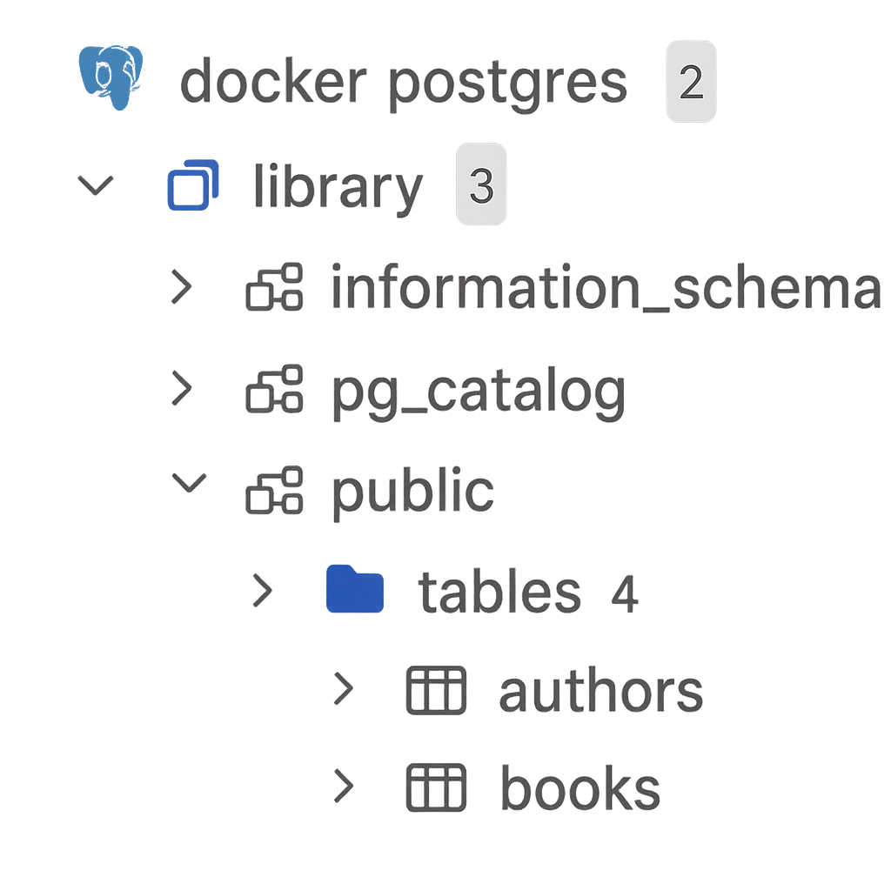
Hibernate Entity/Repo Setup
public interface BookRepository extends JpaRepository<Book, UUID> {}
@Entity @Table(name = "books") …Lombok stuff public class Book { @Id @GeneratedUUIDV7 UUID id; String isbn; String title; int numberOfPages; String printedAuthors; }

Slide 8



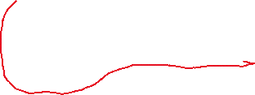
Adding Projection Support (JPQL)
public record BookDTO(UUID id, String isbn, String title, int numberOfPages, String printedAuthors) {}
Entity
Constructor
public interface BookRepository extends JpaRepository<Book, UUID> { @Query("SELECT new com.chapter.projectionsdemo.projections.BookDTO (b.id, b.isbn, b.title, b.numberOfPages, b.printedAuthors) FROM Book b") List<BookDTO> bookDTOProjectionRead(); }
Projection Record

Slide 9
Trade-offs
Good:
Way faster (compared to Entity)
JPQL Query support (compared to raw JDBC)
Immutable (no accidental db saves, no funky state confusion)
There are other great use cases for Projections than just reading a full entity faster (subset of columns, custom query view)
Bad:
More Boilerplate:
Requires an added Class or Record
Requries JPQL constructor expression
Immutable (can’t be used to insert/update into db)

Slide 10
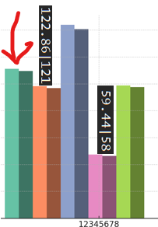

Methodology (1)
Tried to skew the experiment to favorite Entity as much as possible:
No join/relational mapping (projections enable manual, perfect Join queries)
Selecting all columns of table, so ‘Select *’ downsides mitigated
Same dataset is queried many times – prime for caching benefits
Each REST request would be getting its own session anyway, so real-world Entity performance would be closer to the No-Cache results

Slide 11
Methodology (2)
@ParameterizedTest @CsvSource({ "12345, 40", "12345, 500", "123456, 40", "123456, 500", "1234567, 40", "1234567, 500", "12345678, 40", "12345678, 500", }) void runExperiment(int authorSeedSize, int numberOfReadSamples) { seedAuthors(authorSeedSize); seedBooks(BOOKS_PER_AUTHOR); doExperiment(setupBookTestCases(), authorSeedSize, numberOfReadSamples); }
new TestCase("Entity", () -> bookRepository.findAll())
new TestCase("DTO Projection", ()-> bookRepository.bookDTOProjectionRead())
Builds List of Runnable Repo Read Strategies

Slide 12



Methodology (3)
private List<TestCaseResult> doExperimentIteration(List<TestCase> testCases) { return shiftTestCases(testCases).stream().map(TestCaseResult::runTest).toList(); }
private List<TestCase> shiftTestCases(List<TestCase> testCases) { List<TestCase> shiftedCases = new ArrayList<>(testCases); TestCase firstCase = shiftedCases.removeFirst(); shiftedCases.add(firstCase); return shiftedCases; }
public static TestCaseResult runTest(TestCase testCase) { Instant before = Instant.now(); testCase.run(); Instant after = Instant.now(); long duration = after.toEpochMilli() - before.toEpochMilli(); return new TestCaseResult(testCase.name(), duration); }

Slide 13
Worser Projections
There are different techniques for doing a projection query
Not all projection types are the same
Not all projection query techniques are the same
they DO NOT share the same performance benefits
Use a JQPL Constructor expression of a projection class or record for the performance benefits (without requiring an entity load)

Slide 14
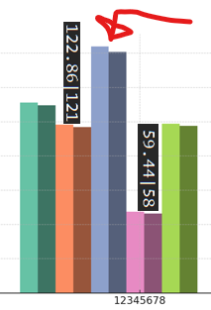
Worser Projections – Interface Projections
This has a cleaner JPQL/Repo function but has the worst performance !
Relies on Dynamic Proxy Generation (reflection) - SLOW
@Query("SELECT b FROM Book b") List<BookInterfaceProjection> bookInterfaceProjectionRead();
public interface BookInterfaceProjection { UUID getId(); String getIsbn(); String getTitle(); int getNumberOfPages(); String getPrintedAuthors(); }

Slide 15
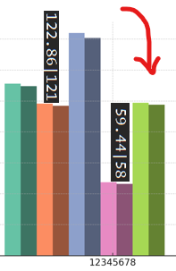
Worser Projections – Entity Constructor
Has no advantage on Entity (because it still loads into an Entity first), but adds more boilerplate
Still requires FQDN Constructor in JPQL (but with fewer params)
@Query("Select new com.chapter.projectionsdemo.projections.BookDTO(b) FROM Book b") List<BookDTO> bookDTOProjectionReadFromEntity();
public BookDTO(Book b){ this( b.getId(), b.getIsbn(), b.getTitle(), b.getNumberOfPages(), b.getPrintedAuthors() ); }

